Slide 1
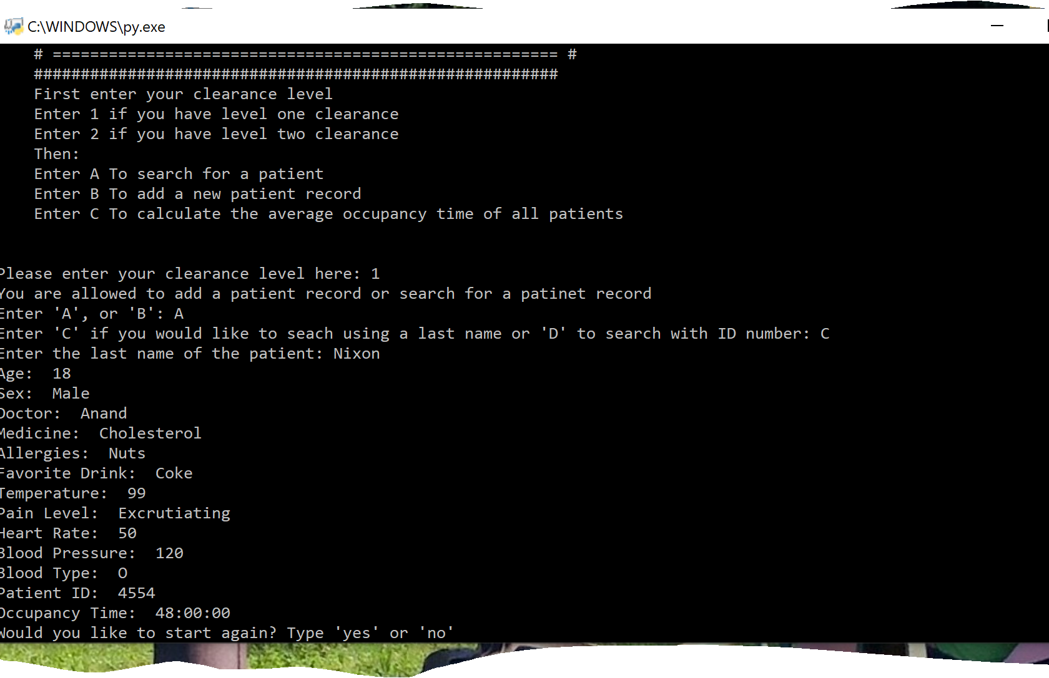
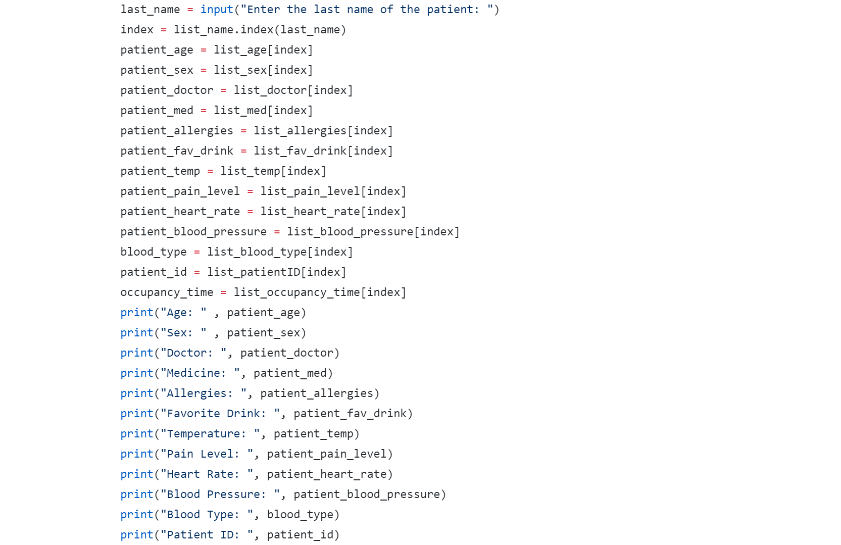
Coder: Alexis Nixon Project: Patient Questionnaire in E.R. Example Used: From Lulit Asfaw
Preference Questionnaire about patients for a more personable visit to E.R.
Asks questions to cater more to patients and their individual wants with out having to answer the same questions over and over
This will also keep track of the amount of time a patient has spent in the hospital, this will help the E.R. to cut down on average time a patient spends in hospital.

